Slide 1
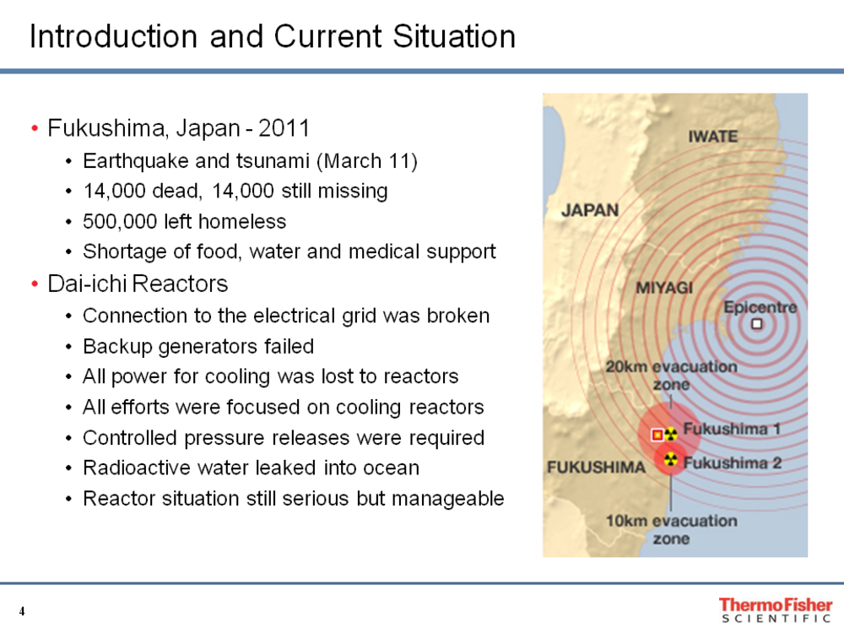

Slide 2
3-11-11 RPS Actions
Instruct staff to put hands on all routine air monitors and report equipment status
Contact sampling partners to give notice of possible future increased environmental sampling.
Submit RE for possible use of backup contract lab for analysis efforts.

Slide 3
RPS Routine Monitoring
24/7 365 days a year low volume air monitoring around all fixed nuclear facilities. (Analyzed weekly at 12 sites)
24 hour high volume air sampling: Morganton, Currituck, Albemarle, Raleigh (Analyzed monthly)
Monthly milk producers; “raw” water, “finished” water, surface water and sewage
Quarterly shellfish
Semiannual Vegetation, Soil, Fish and Groundwater
Annual TLD

Slide 4
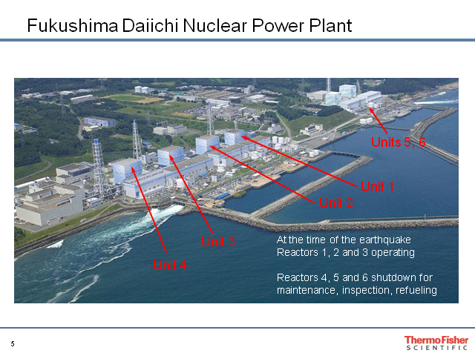

Slide 5
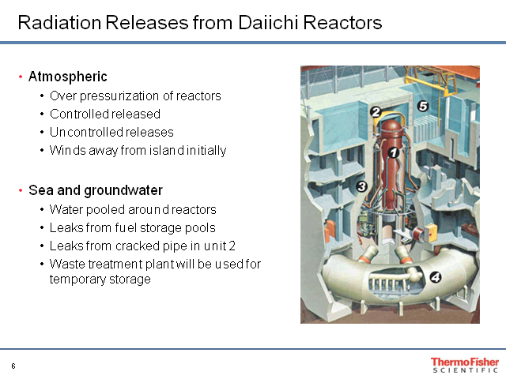

Slide 6
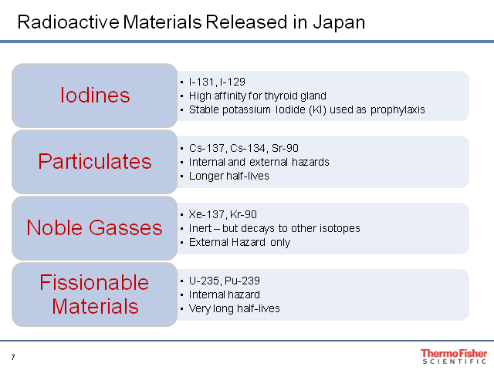

Slide 7
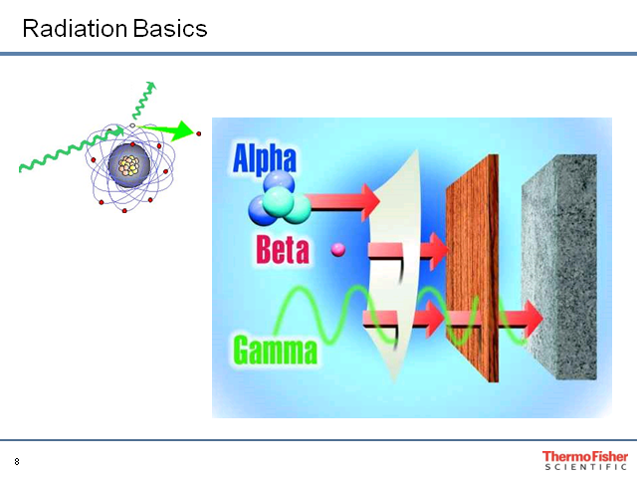

Slide 8
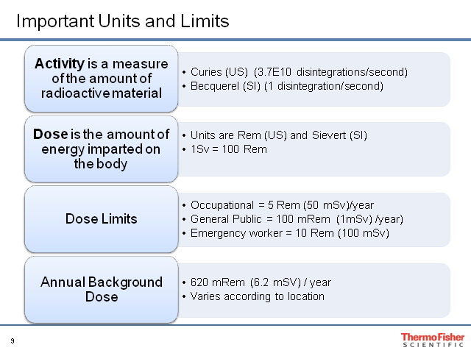

Slide 9
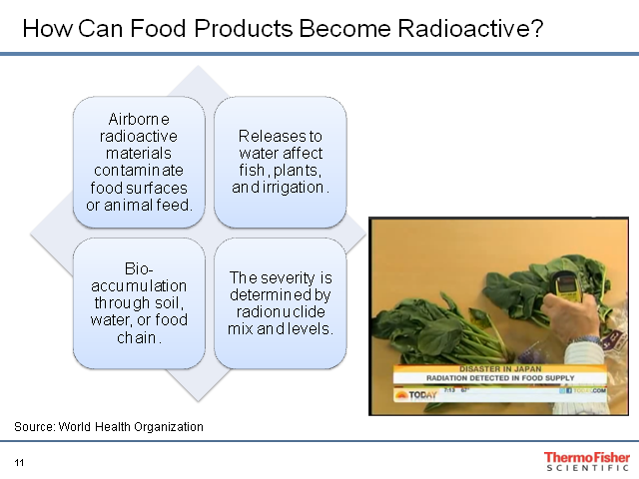

Slide 10
Timeline of Events
3-11-11 Residents within 3 km of Reactor 1 evacuated. Those within 10km sheltered.
3-16-11 NRC recommended US Citizens to evacuate if within 50 miles or 80 km. Japan evacuated its Citizens within 12 miles or 20km
3-25-11 Japan amended its evacuation to 18 miles or 30 km.
3-25-11 NC nuclear power plants report minimum levels of I-131 in Air Samples

Slide 11
Timeline (cont.)
3-26-11 RPS increases env. sampling effort
4-12-11 to 7-6-11 RPS reports some combination of I-131, Cs-137, or Cs-134 in 72 of 577 Samples.
No detection in Surface Water, Drinking or Shellfish
5-11-11 RPS last detection of fission products.
No Public health threat to date or expected.

Slide 12
RPS Sample Results
Sample Media | RPS Results | Regulatory Limit | RPS Invest. Limit
Air Particulate | .01 to .03 pCi/m3 I-131 | 1.0 pCi/m3 | 0.5 pCi/m3 I-131
Air Iodine | .05 to .20 pCi/m3 I-131 | 200 pCi/m3 | 0.1 pCi/m3 I-131
Milk | 9.0 to 10.0 pCi/L I-131 | 4,700 pCi/L | 10 pCi/L I-131
Vegetation | .02 to .3 pCi/g I-131/Cs-137 | None | 10 pCi/g I-131
Precipitation | <1.0 to 172 pCi/m2 I-131 | None | 10 pCi/m2 I-131
Surface Water | 22.1 pCi/L I-131 | 1,000 pCi/L | 1 pCi/L I-131
Soil | None Detected | None | 7 pCi/g I-131
Sewage Effluent | None Detected | 10,000 pCi/L | 100 pCi/L I-131
Groundwater | None Detected | 3 pCi/L | None
Shellfish | None Detected | None | 1 pCi/g Cs-137
Fish | None Detected | None | 1 pCi/g Cs-137

Slide 13
Federal Food Safety
FDA analyzed 1077 samples from Japan. One sample positive for Cesium-137 – well below DIL.
FDA issues Import Alert 99-33 to deal with Japanese food imports
Food from six prefectures restricted or banned
FDA and Customs and Border Patrol continue to screen all food imports from Japan

Slide 14
EPA Monitoring
Environmental Protection Agency monitored rad levels via RadNet
Over 100 continuous air monitors in RadNet
3-18-11 – First reports of elevated rad readings in continental US
Trace amounts of I-131 and “other radionuclides” detected
5-3-11 – RadNet returns to normal operation

Slide 15
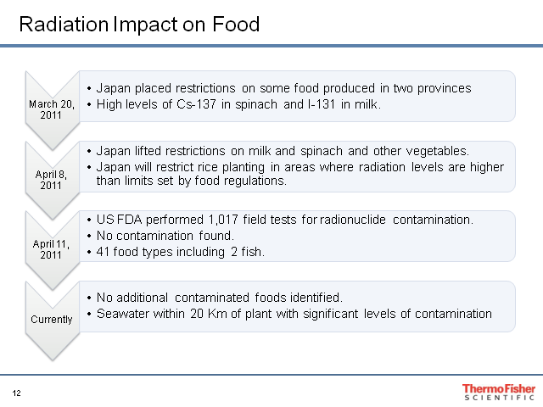

Slide 16
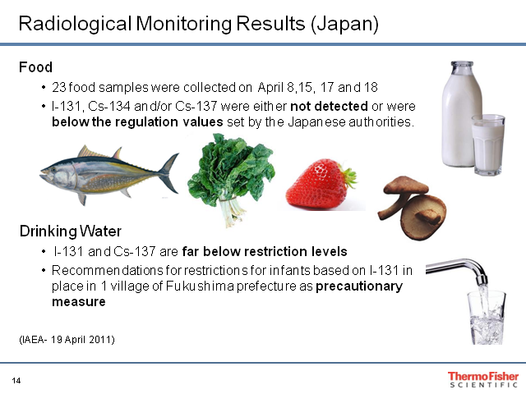

Slide 17
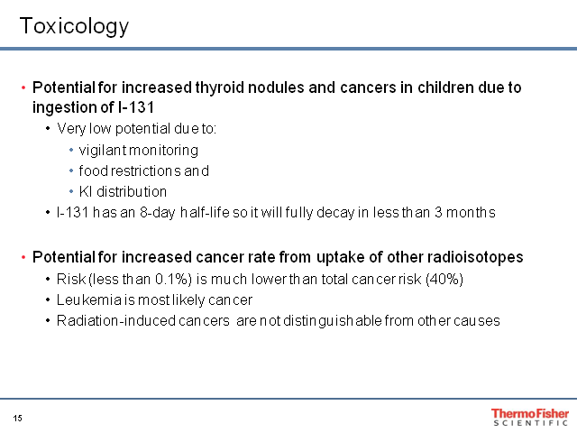

Slide 18
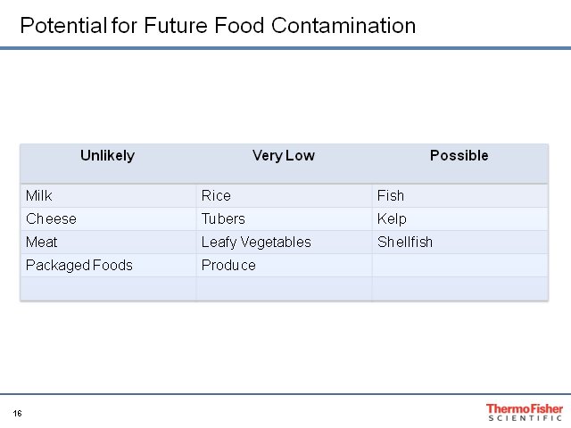

Slide 19
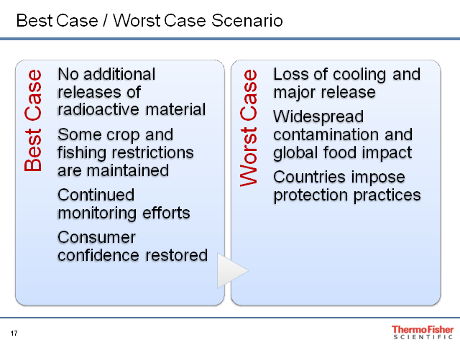

Slide 20
Acknowledgements
Ken Kerns, Iowa State University
Thermo Fisher, Inc.

